Slide 1
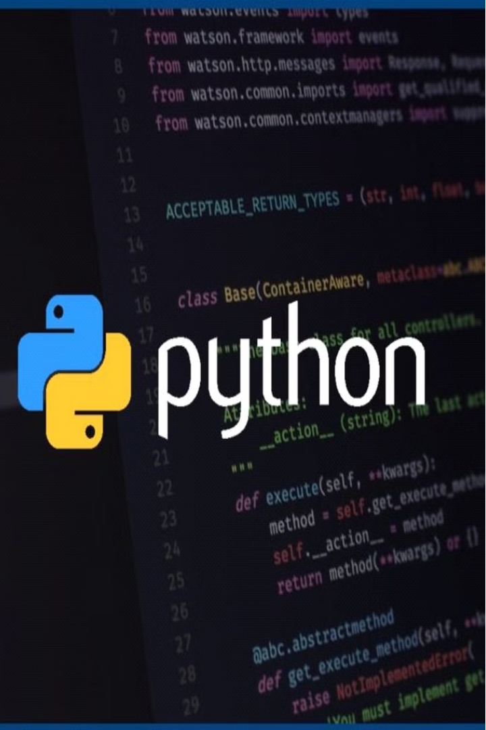
Python Programming Language
Lecture 1: Introduction to Python
Hafsa Sultana
Computer Science and Engineering
Khulna University

Slide 2
Today’s Learning Objectives
What is Programming?
Types of Programming Languages
Why python
Python Career Opportunities
Different IDE Tools for Python
Environment Set Up
Our First Python Program
Python indentation
Python Comment
Input and Output (print function)
Fun and Interactive Coding Exercises
Where to Learn More About Python
Hafsa Sultana, CSE, KU

Slide 3
What is Programming?
1
Problem Solving
2
Creativity and Automatic
Tasking
3
Logic and Thinking
Programming is the art of breaking down complex problems into smaller, manageable steps and then writing instructions for the computer to follow to solve those problems.
Programming requires logical thinking and the ability to break down problems into their components. It helps develop critical thinking skills.
Programming allows you to bring your ideas to life and create something unique. It is a way to express your creativity and solve various difficult amazing problems automatically.
Hafsa Sultana, CSE, KU

Slide 4
Types of Programming Languages
1
Low-Level Languages:
2
High-Level Languages:
Machine Language: Binary code directly executed by the computer.
Assembly Language: Uses symbolic code and is closer to machine language.
Object-Oriented Languages: Python, Java, C++ (Based on objects and classes).
Scripting Languages: Python, JavaScript, PHP (Automate tasks, often interpreted).
Markup Languages: HTML, XML (Web development)
Concurrency-Oriented Languages: GO, Rust (to handle parallel computations)
Hafsa Sultana, CSE, KU

Slide 5
Why Python?
Easy to Learn
Interpreted Language
Object-Oriented Language
Works on Different Platforms
(Windows, Mac, Linux etc.)
Extensive Standard Library
High-Level Language
Open Source
Large Community
Developer Community
Hafsa Sultana, CSE, KU

Slide 6
Python
It was created by Guido van Rossum, and released in 1991.
Python is a versatile and beginner-friendly programming language that can help you create amazing things, from websites to video games.
Python 3 has a simple syntax that is simple to understand and read, making it a good choice for beginners.
It is a high-level language that has a large standard library and many third-party libraries available, making it a versatile language that can be used for a wide variety of applications.
Python 3 has good support for data analysis and scientific computing, with libraries such as NumPy and Pandas.
Hafsa Sultana, CSE, KU

Slide 7
Python Career Opportunities
Web Development
Data Science
Backend Developer, Full Stack Developer
Data Scientist, Data Analyst, Machine Learning Engineer
Game Development
Automation
Game Developer, Game Scripter
Automation Engineer, DevOps Engineer.
Hafsa Sultana, CSE, KU

Slide 8
Python Career Opportunities (Cont..)
Software Development
Cybersecurity
Software Engineer, Python Developer
Security Analyst, Penetration Tester, Ethical Hacker
Artificial Intelligence (AI) and Machine
Learning (ML):
Education and Training
Instructor, Curriculum Developer
AI Engineer, ML Engineer, Research Scientist
Hafsa Sultana, CSE, KU

Slide 9
# Let’s Start Coding
Hafsa Sultana, CSE, KU

Slide 10
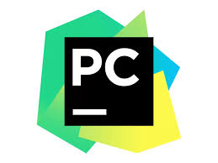




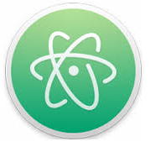
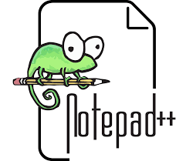
Different IDE Tools for Python
1. PyCharm
3. Jupyter Notebook
2. Visual Studio Code (VS Code)
4. Spyder
5. Others: Sublime Text, Atom, Notepad++ etc.
Hafsa Sultana, CSE, KU

Slide 11
Setting Up the Development Environment
1
Install Python
The first step is to download and install the latest version of Python on your computer.
https://www.python.org/downloads/ , https://www.jetbrains.com/pycharm/download ,
https://www.anaconda.com/download
2
Choose an IDE
An Integrated Development Environment (IDE) is a software application that provides a comprehensive set of tools for writing, testing, and debugging code.
3
Start Coding
With Python and your chosen IDE installed, you're ready to start coding and exploring the exciting world of programming!
Hafsa Sultana, CSE, KU

Slide 12
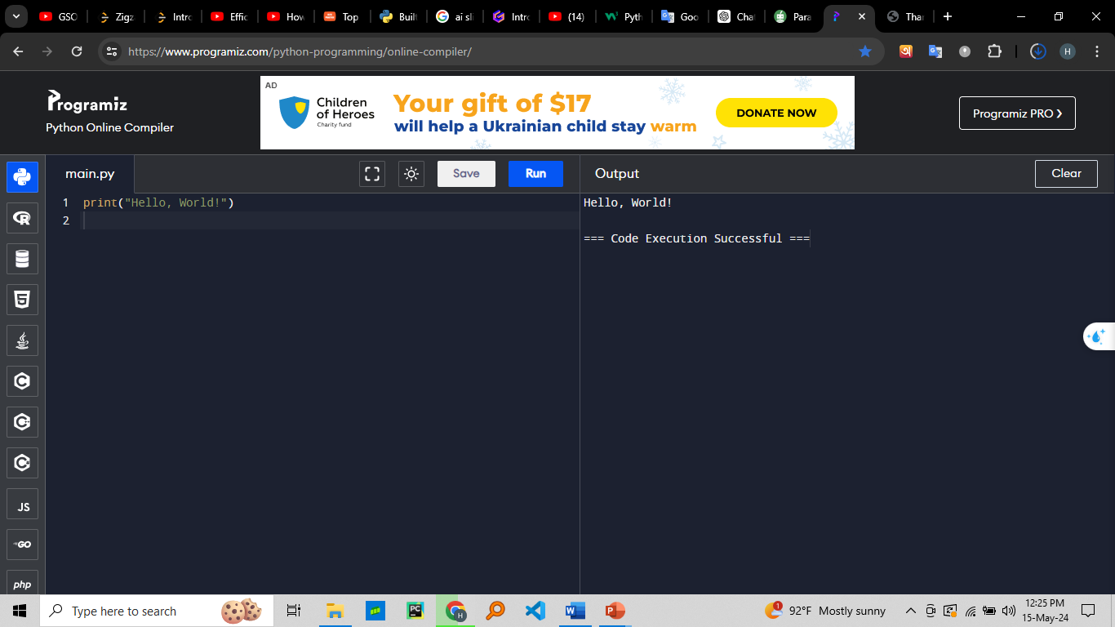
Our First Python Program
Open your IDE or text editor
Create a new file named hello.py
Type the following code:
Hafsa Sultana, CSE, KU

Slide 13
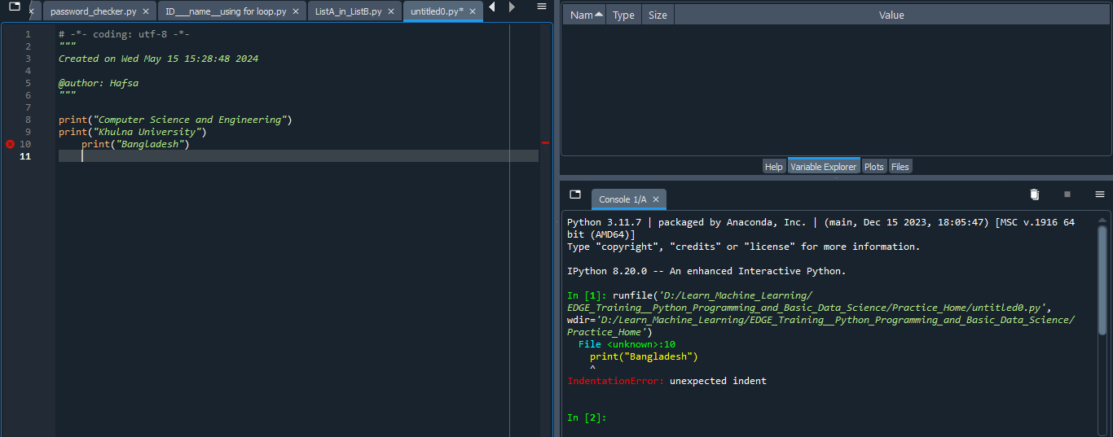
Python Indentation
Hafsa Sultana, CSE, KU

Slide 14
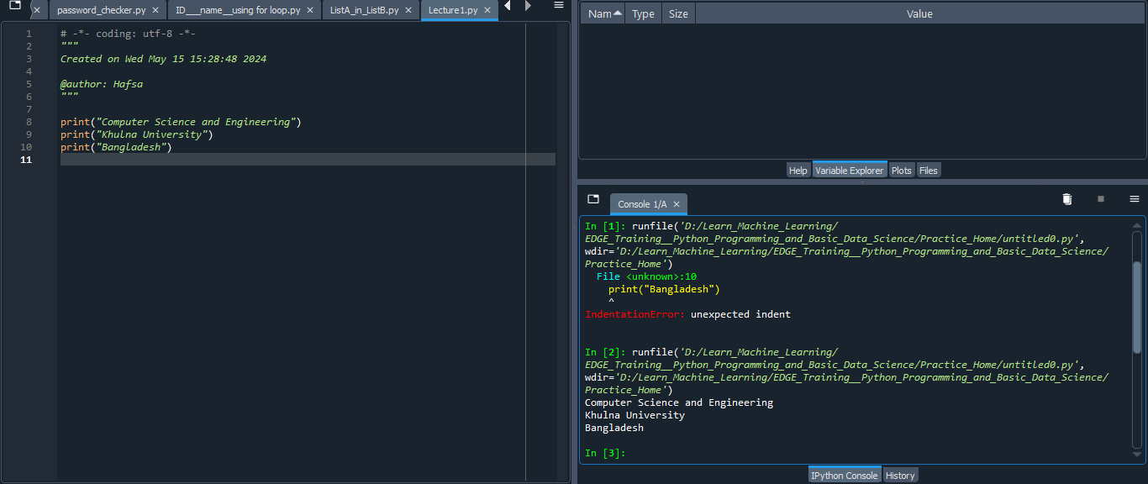
Python Indentation
Hafsa Sultana, CSE, KU

Slide 15
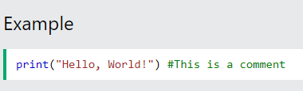
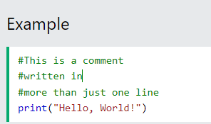
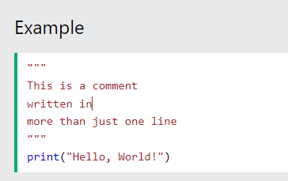
Python Comment
Hafsa Sultana, CSE, KU

Slide 16




Input and Output (print function)
print()
input()
Variables
Strings
The print() function is used to display output in the console or terminal.
The input() function allows the user to provide data or instructions to the program.
Variables are used to store and manipulate data in your programs.
Strings are used to represent text in Python, and can be used with the print() and input() functions.
Hafsa Sultana, CSE, KU

Slide 17




Fun and Interactive Coding Exercises
Greeting Message:
Sum of Two Numbers:
Repeating a Message:
name = “Sajid”
print("Hello,", name, "!")
#output- Hello Sajid!
num1=5
num2=6
sum = num1 + num2
print("Sum:", sum)
#Output = Sum:11
message = “Be Honest.”
repeat = 5
print(message * repeat)
#Output: Be Honest.Be Honest.Be Honest.Be Honest.Be Honest.
Hafsa Sultana, CSE, KU

Slide 18
Practice… Practice… Practice…
Hafsa Sultana, CSE, KU

Slide 19
Where to Learn More About Python
Online Tutorials
Websites like Python.org, w3schools, Codecademy, and Udemy offer interactive tutorials and courses for learning Python.
Books and Ebooks
There are many great books and ebooks available that provide in-depth coverage of the Python language and its applications.
Python Community
Joining online communities like Python subreddit or Python meetup groups can provide valuable support and resources.
Project-Based Learning
Building your own projects is one of the best ways to solidify your Python skills and learn new concepts.
Hafsa Sultana, CSE, KU

Slide 20
# Any Question??

